Slide 1


Strengthening Privacy in Federated Learning via Key-Switchable Homomorphic Encryption.
Presented by:
Mohamad Ibrahim
Supervised by:
Dr. Khalil Haris
Dr. Chantal Hajjar
Hosted by:
CentraleSupélec

Slide 2
Outline
Homomorphic Encryption (HE): Overview
Data Privacy
Federated Learning (FL): Overview
HE Importance in FL
Security Risks & Their Solution Designs
xMK CKKS: Overview, Setup, Network & Problematic
DF-KS: Setup, Network & Issues
Implementation
Results
Conclusion: Summary & Future Works

Slide 3


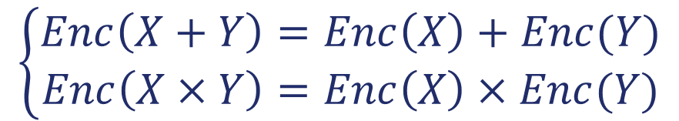
1. Homomorphic Encryption Overview
HE is a form of encryption that permits computation over encrypted data
$$\left\{\begin{aligned}Enc\left(X+Y\right)=Enc\left(X\right)+Enc(Y) \\ Enc\left(X×Y\right)=Enc\left(X\right)×Enc(Y)\end{aligned}\right.$$
This type of encryption usually requires all ciphertexts from all clients to use the same key.
FL Clients
X
Y
Encrypt
Encrypt
FL Server
HE Add
X+Y
Decrypt
FL Clients
X+Y

Slide 4
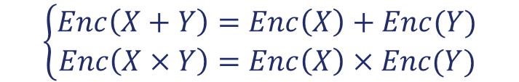
1. Homomorphic Encryption Overview
HE is a form of encryption that permits computation over encrypted data
FL Clients
X
Y
$$\left\{\begin{aligned}Enc\left(X+Y\right)=Enc\left(X\right)+Enc(Y) \\ Enc\left(X×Y\right)=Enc\left(X\right)×Enc(Y)\end{aligned}\right.$$
Encrypt
Encrypt
FL Server
HE Add
X+Y
This type of encryption usually requires all ciphertexts from all clients to use the same key.
Decrypt
FL Clients
X+Y

Slide 5
2. Data Privacy
GDPR: European law stands for General Data Protection Regulation
Article N° | Statement
9 | Defines special categories data and prohibit processing them
32 | Mandates protection for all personal data including special categories
44 | Prohibit the transfer of data outside unless the protection is ensured
FL Clients
X
Y
Encrypt
Encrypt
FL Server
HE Add
Special Category Healthcare Dataset
Protect Data Weight & Bias/Gradient Generated by the Model
Transfer FL
Protection HE
X+Y
Decrypt
FL Clients
X+Y

Slide 6
2. Data Privacy
GDPR: European law stands for General Data Protection Regulation
Article N° | Statement
9 | Defines special categories data and prohibit processing them
32 | Mandates protection for all personal data including special categories
44 | Prohibit the transfer of data outside unless the protection is ensured
Special Category Healthcare Dataset
Protect Data Weight & Bias/Gradient Generated by the Model
Transfer FL
Protection HE

Slide 7





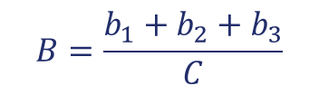



3. Federated Learning Overview
Federated Learning (FL) is a decentralized machine-learning framework where clients train a shared global model by performing local updates on their private data.
$$w_{1}, b_{1}, c_{1}$$
Article N° | Statement
9 | Defines special categories data and prohibit processing them
32 | Mandates protection for all personal data including special categories
44 | Prohibit the transfer of data outside unless the protection is ensured
Local model 1
Local model 2
$$w_{2}, b_{2}, c_{2}$$
Global model
$$FedAVG$$
(average)
Local model 3
$$w_{3}, b_{3}, c_{3}$$
$$C=c_{1}+c_{2}+c_{3}$$
Special Category Healthcare Dataset
Protect Data Weight & Bias/Gradient Generated by the Model
Transfer FL
Protection HE
$w:weights$
$b:bias$
$c:data size$
$$W=\frac{w_{1}+w_{2}+w_{3}}{C}$$
$$B=\frac{b_{1}+b_{2}+b_{3}}{C}$$
$$R rounds$$

Slide 8





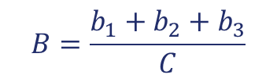



3. Federated Learning Overview
Federated Learning (FL) is a decentralized machine-learning framework where clients train a shared global model by performing local updates on their private data.
Local model 1
$$w_{1}, b_{1}, c_{1}$$
Local model 2
$$w_{2}, b_{2}, c_{2}$$
Global model
$$FedAVG$$
(average)
Local model 3
$$w_{3}, b_{3}, c_{3}$$
$$C=c_{1}+c_{2}+c_{3}$$
$w:weights$
$b:bias$
$c:data size$
$$W=\frac{w_{1}+w_{2}+w_{3}}{C}$$
$$B=\frac{b_{1}+b_{2}+b_{3}}{C}$$
$$R rounds$$

Slide 9





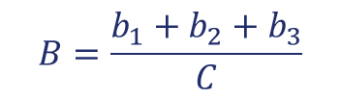



Local model 1
$$w_{1}, b_{1}, c_{1}$$
Local model 2
$$w_{2}, b_{2}, c_{2}$$
Global model
$$FedAVG$$
(average)
Local model 3
$$w_{3}, b_{3}, c_{3}$$
$$C=c_{1}+c_{2}+c_{3}$$
$w:weights$
$b:bias$
$c:data size$
$$W=\frac{w_{1}+w_{2}+w_{3}}{C}$$
$$B=\frac{b_{1}+b_{2}+b_{3}}{C}$$
$$R rounds$$
4. HE Importance in FL
Stage | Importance of HE
Local Training | Allows local training on plaintext data with no need of encryption
Server Aggregation | Ensure computation on ciphertext and prevent access to local data
Parameters | Prevent leakage of sensitive data
Security & Privacy | Protect against membership inference, and curious server attacks
Traditional fashion of HE not enough due to security risk

Slide 10
5. Security Risks
Using the same key across all clients poses security risks
Risk | Description
Honest-but-curious clients | Client will follow the protocol correctly but will exploit opportunities to access private data, leading to privacy leakage
Key compromise issue | All clients share one decryption key; compromising a single device reveals this key. This means one breach compromise the entire FL network

Slide 11
5. Security Risks
(Solution Design)
Solution Design
Proposed Solution
xMK CKKS
DF-KS
Based on an asymmetric encryption
Based on a symmetric encryption
Have homomorphic properties
Solve the mentioned security risks
Suitable for the FL network

Slide 12
6. xMK CKKS
(CKKS Overview)
Published in 2017
Asymmetric Encryption
xMK CKKS is modification of the CKKS scheme which is:
Latice-Based HE (based on RLWE)
Supports Approximate Computation
Suitable for FL applications

Slide 13
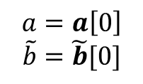

6. xMK CKKS
(Basic Notations)
Parameter | Notations
Plain text of device $i$ | $$m_{i}$$
Private key of device $i$ | $$s_{i}$$
Public key of device $i$ | $$b_{i}=−s_{i}×a+e_{i}$$
Aggregated public keys | $$\tilde{b}=\sum_{i=1}^{N}{b_{i}}$$
Ciphertext of the plain text $m_{i}$ (encryption) | $$\begin{aligned}&c_{0}^{d_{i}}= v_{i}∙\tilde{b}+m_{i}+e_{0}^{d_{i}} mod q \\ &c_{1}^{d_{i}}= v_{i}∙a+e_{1}^{d_{i}} mod q\end{aligned}$$
Aggregated ciphertexts | $$C_{sum}=\left(C_{sum0},C_{sum1}\right) mod q$$
Partial decryption of device $i$ | $$D_{i}= s_{i}∙C_{sum1}+e_{i}^{∗} mod q$$
Aggregated plain texts (decryption) | $$C_{sum0}+\sum_{i=1}^{N}{D_{i}} mod q ≈ \sum_{i=1}^{N}{m_{i}}$$
$$a=a\left[0\right]$$
$$\tilde{b}=\tilde{b}[0]$$
Homomorphic
Property

Slide 14



6. xMK CKKS
(Public Keys Aggregation)
Client 1
$$b_{1}$$
Aggregated public keys
$$\tilde{b}=b_{1}+b_{2}$$
Client 2
$$b_{2}$$
Aggregated public keys from all clients are required to encrypt the message.

Slide 15



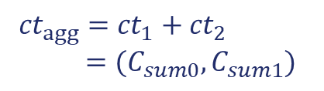

6. xMK CKKS
(Ciphertext Aggregation)
Client 1
$$ct_{1}={(c}_{0}^{d_{1}},c_{1}^{d_{1}})=Enc(w_{1},\tilde{b})$$
Server
${ct}_{agg}={ct}_{1}+{ct}_{2}$
$=(C_{sum0},C_{sum1})$
Client 2
$$ct_{2}={(c}_{0}^{d_{2}},c_{1}^{d_{2}})=Enc(w_{2},\tilde{b})$$
$$C_{sum1}$$
is sent back to the clients to compute their partial decryption
$$D_{i}= s_{i}∙C_{sum1}+e_{i}^{∗} mod q$$

Slide 16



6. xMK CKKS
(Collaborative Decryption)
Client 1
$$D_{1}$$
Server
$$D=D_{1}+D_{2}$$
Client 2
$$D_{2}$$
All Partial Decryption from all clients are required for decryption which solve the mentioned security risks. However, the decryption becomes impossible if one key share is missing.

Slide 17
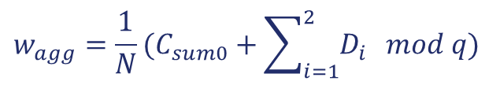


6. xMK CKKS
(Collaborative Decryption)
Client 1
$$D_{1}$$
$$w_{agg}=\frac{1}{N}(C_{sum0}+\sum_{i=1}^{2}{D_{i}} mod q)$$
Server
Client 2
$$D_{2}$$
Decryption is done only on server side;
Clients can’t decrypt the aggregated message independently.

Slide 18
6. xMK CKKS (Problematics)
Decryption happens on server side
The objective of this research is to solve these issues.
xMK CKKS
All clients required for decryption

Slide 19
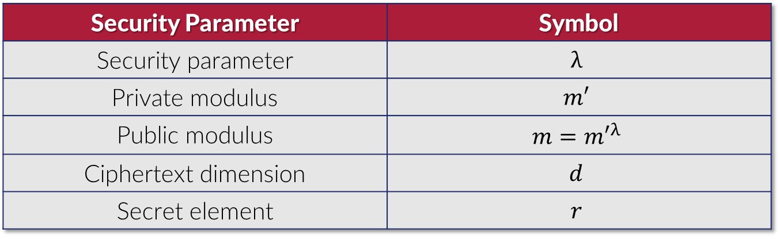
7. DF-KS Scheme
(DF)
Security Parameter | Symbol
Security parameter | $$λ$$
Private modulus | $$m′$$
Public modulus | $$m={m′}^{λ}$$
Ciphertext dimension | $$d$$
Secret element | $$r$$

Slide 20
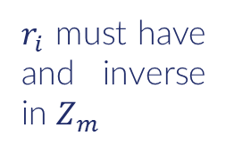

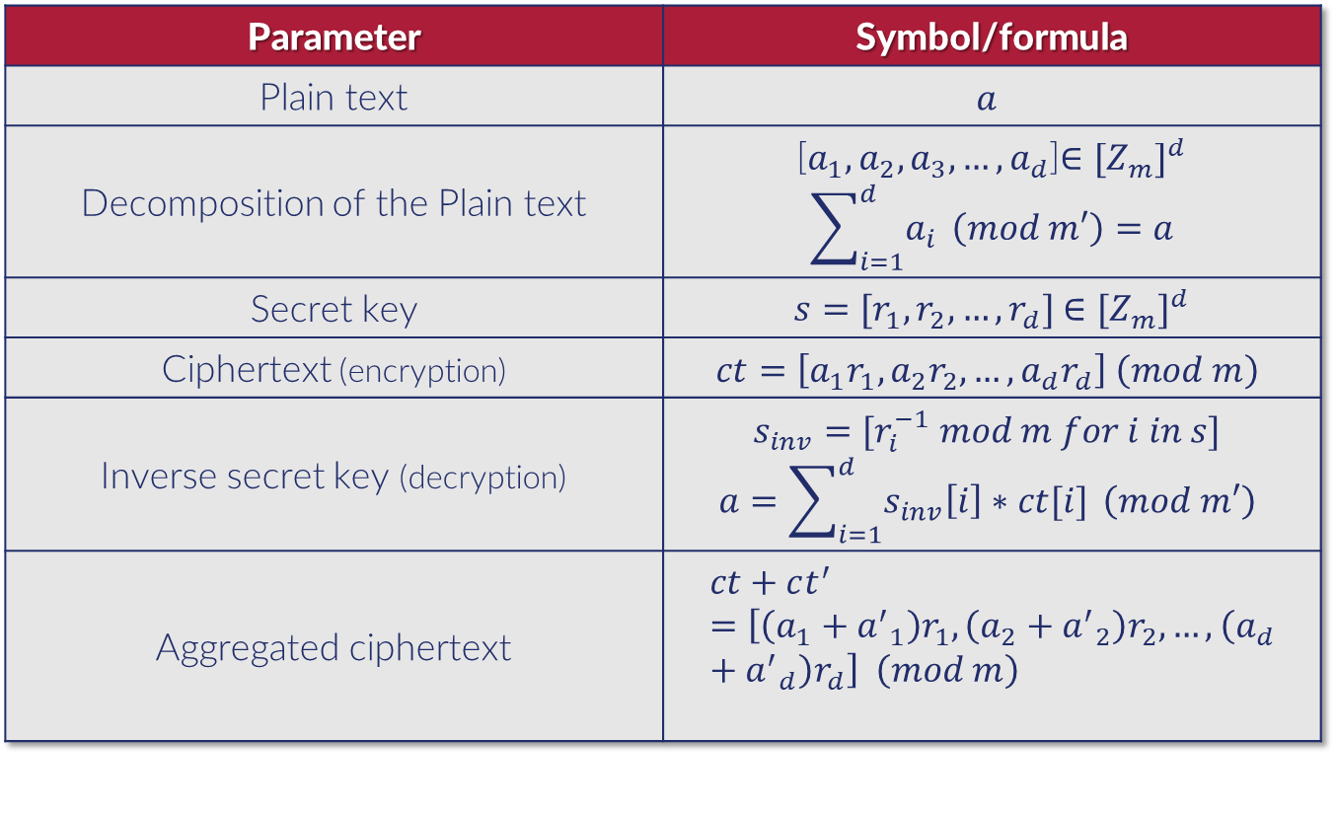
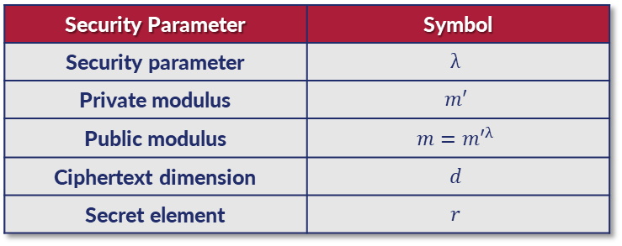
7. DF-KS Scheme
(DF)
$$r_{1},r_{2}$$
Security Parameter | Symbol
Security parameter | $$λ$$
Private modulus | $$m′$$
Public modulus | $$m={m′}^{λ}$$
Ciphertext dimension | $$d$$
Secret element | $$r$$
Parameter | Symbol/formula
Plain text | $$a$$
Decomposition of the Plain text | [$a_{1}, a_{2},a_{3},…,a_{d}$]$∈{[Z_{m}]}^{d}$ $$\sum_{i=1}^{d}{a_{i}} \left(mod m′\right)=a$$
Secret key | $s=[r_{1},r_{2},…,r_{d}]$ $∈{[Z_{m}]}^{d}$
Ciphertext (encryption) | $$ct=\left[a_{1}r_{1}, a_{2}r_{2},…,a_{d}r_{d}\right] \left(mod m\right)$$
Inverse secret key (decryption) | $$s_{inv}=[r_{i}^{−1} mod m for i in s]$$ $$a=\sum_{i=1}^{d}{s_{inv}\left[i\right]∗ct[i]} \left(mod m′\right)$$
Aggregated ciphertext | $$ct+ct^{′}=\left[\left(a_{1}+{a^{′}}_{1}\right)r_{1}, \left(a_{2}+{a^{′}}_{2}\right)r_{2},…, \left(a_{d}+{a^{′}}_{d}\right)r_{d}\right] \left(mod m\right)$$
$r_{i}$ must have and inverse in $Z_{m}$
Homomorphic
property

Slide 21




7. DF-KS Scheme (KS)
Key Switching (KS) is a technique that transforms data encrypted under one key into an equivalent ciphertext under another key without decrypting it.
Switched key remains secure due to the Hardness of Learning with Error (LWE)
$$M=\left(\begin{matrix}b \\ A\end{matrix}\right)$$
$${dec}_{s^{∗}}\left(c^{∗}\right)={dec}_{s′}\left(c′\right)$$
$$c^{′}=Mc^{∗}$$
$$b= −t^{′}A+m^{′}e+s_{inverse}^{∗}$$
New
cipher text
Old
cipher text
Public matrix

Slide 22


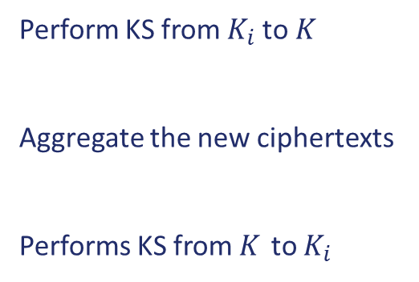

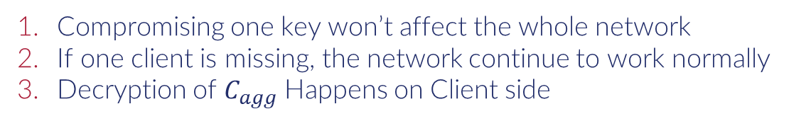


7. DF-KS Scheme
(Network)
Client 1
$${C′}_{agg1}=Enc(w_{agg},K_{1})$$
Perform KS from $K_{i}$ to $K_{ }$
Aggregate the new ciphertexts
Performs KS from $K_{ }$ to $K_{i}$
$$C_{1K_{1}}=Enc\left(w_{1},K_{1}\right) M_{1}$$
Server
$$C_{agg}=C_{1K}+C_{2K}^{ }=Enc(w_{Aggr},K)$$
Client 2
$$C_{2K_{2}}=Enc\left(w_{2},K_{2}\right) M_{2}$$
$${C′}_{agg2}=Enc(w_{agg},K_{2})$$
Compromising one key won’t affect the whole network
If one client is missing, the network continue to work normally
Decryption of $C_{agg}$ Happens on Client side

Slide 23



7. DF-KS Scheme
(KS crypt analysis)
$$M=\left(\begin{matrix}b \\ A\end{matrix}\right)$$
$$b= −t^{′}A+m^{′}e+s_{inverse}^{∗}$$
2 Clients:
$$M_{1} →d equations with:\left[s_{1}^{\left(1\right)},s_{2}^{\left(1\right)},…,s_{d}^{\left(1\right)}\right],\left[s_{1},s_{2},…,s_{d}\right],\left[e_{1}^{\left(1\right)},e_{2}^{\left(1\right)},…,e_{d}^{\left(1\right)}\right],m′$$
$$M_{2} →d equations with:\left[s_{1}^{\left(2\right)},s_{2}^{\left(2\right)},…,s_{d}^{\left(2\right)}\right],\left[s_{1},s_{2},…,s_{d}\right],\left[e_{1}^{\left(2\right)},e_{2}^{\left(2\right)},…,e_{d}^{\left(2\right)}\right],m′$$
$$M_{1}^{inv} →d equations with:\left[s_{1}^{\left(1\right)},s_{2}^{\left(1\right)},…,s_{d}^{\left(1\right)}\right],\left[s_{1},s_{2},…,s_{d}\right],\left[e_{1}^{\left(1inv\right)},e_{2}^{\left(1inv\right)},…,e_{d}^{\left(1inv\right)}\right],m′$$
$$M_{2}^{inv} →d equations with:\left[s_{1}^{\left(2\right)},s_{2}^{\left(2\right)},…,s_{d}^{\left(2\right)}\right],\left[s_{1},s_{2},…,s_{d}\right],\left[e_{1}^{\left(2inv\right)},e_{2}^{\left(2inv\right)},…,e_{d}^{\left(2inv\right)}\right],m′$$
$$for 2 clients →4d equations with 7d+1 unknown (safe)$$
$$for n clients →(2n)d equations with (3n+1)d+1 unknown (safe)$$
$$by induction$$

Slide 24
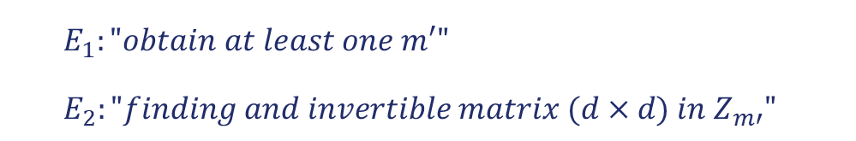

7. DF-KS Scheme (Issue)
If an attacker have
$$M=2×poly\left(λ\right)×\left(d+1\right)$$
Couples of plaintext/ciphertext
He can recover the secret key $s$ if these two independent events are satisfied
$E_{1}:"obtain at least one m′"$
$E_{2}:"finding and invertible matrix (d×d) in Z_{m′}"$
$$P\left(key recovery\right)=P\left(E_{1}∩E_{2}\right)=P\left(E_{1}\right)×P\left(E_{2}\right)$$

Slide 25

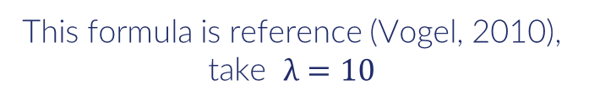
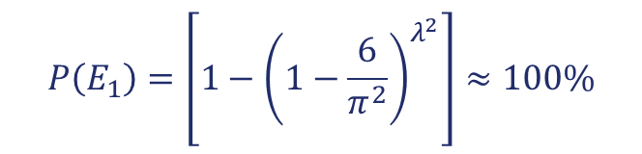
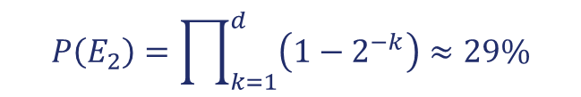
7. DF-KS Scheme (Issue)
$$P\left(E_{1}\right)=\left[1−{\left(1−\frac{6}{π^{2}}\right)}^{λ^{2}}\right]≈100\%$$
$$P\left(E_{2}\right)=\prod_{k=1}^{d}{\left(1−2^{−k}\right)}≈29\%$$
This formula is reference (Vogel, 2010),
take $λ=10$
Ask me after presentation if interested why ☺
$$P\left(key recovery\right)≈29\%$$
Vulnerable to couple plaintext/ciphertext attack !!!

Slide 26
8. Implementation
(FL Setup)
FL Setup
Dataset | PIMA Indian diabetes
Size of data | 900 samples (8 features)
Server model | FedAVG
Local Model | Logistic regression with 10 epoch/client
Rounds | 10
Data split | 40% (client 1), 40% (client 2), 20% (testing data)
Planned improvements | Larger dataset with Neural Network model

Slide 27
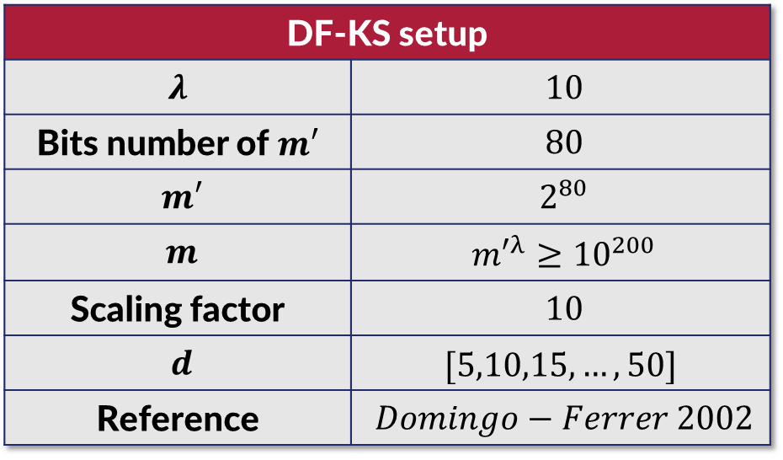
8. Implementation (DF-KS Setup)
DF-KS setup
$λ^{ }$ | $10$
Bits number of $m′$ | $80$
$m′$ | $2^{80}$
$m$ | ${m′}^{λ}≥{10}^{200}$
Scaling factor | $10$
$d$ | $[5,10,15,…,50]$
Reference | $Domingo−Ferrer 2002$

Slide 28
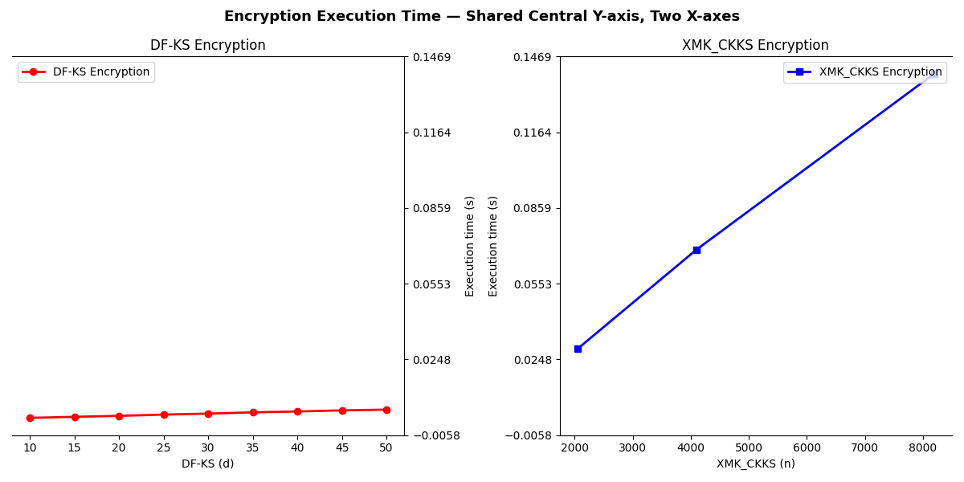
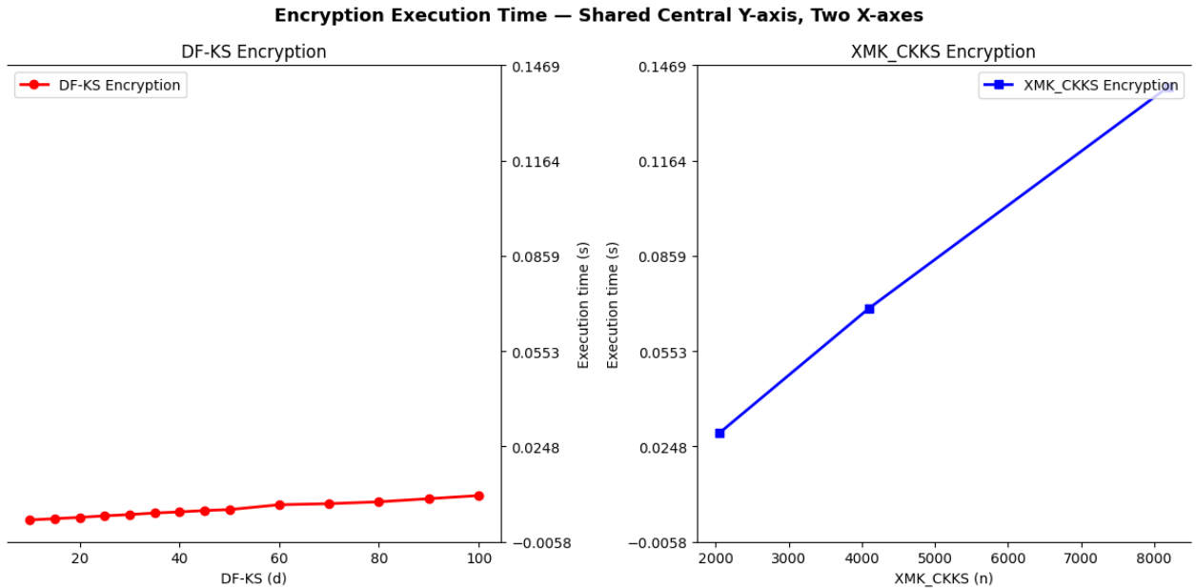
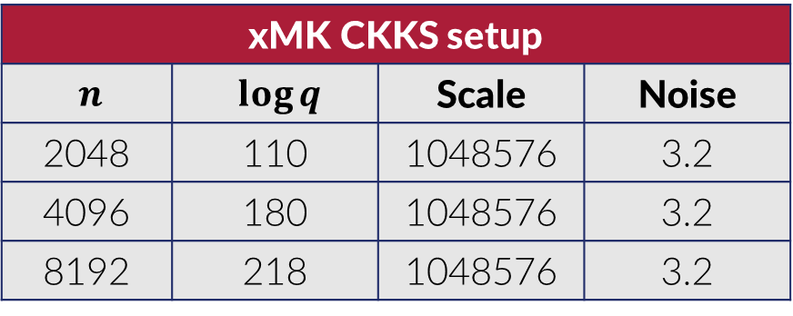
8. Implementation (xMK CKKS Setup)
xMK CKKS setup
$n$ | $\log{q}$ | Scale | Noise
2048 | 110 | 1048576 | 3.2
4096 | 180 | 1048576 | 3.2
8192 | 218 | 1048576 | 3.2
Choice of parameters reference: Microsoft SEAL

Slide 29
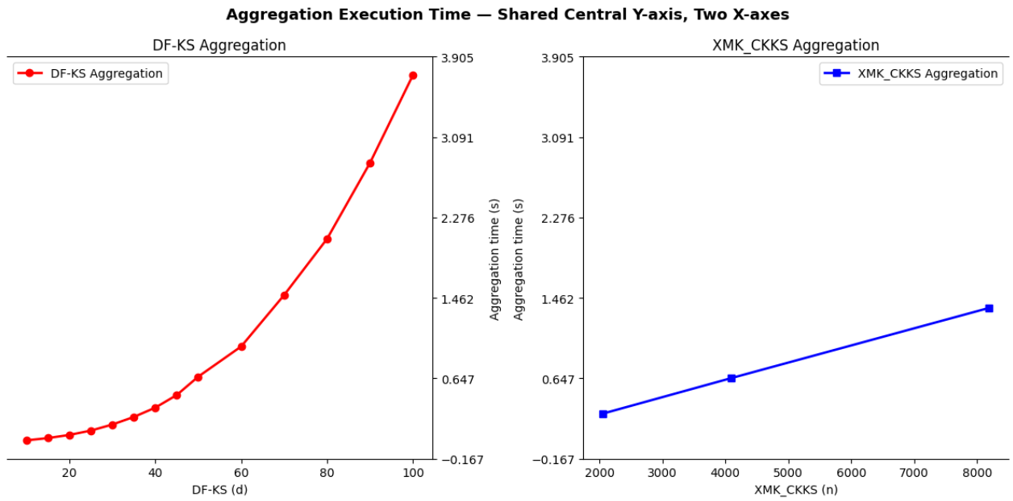
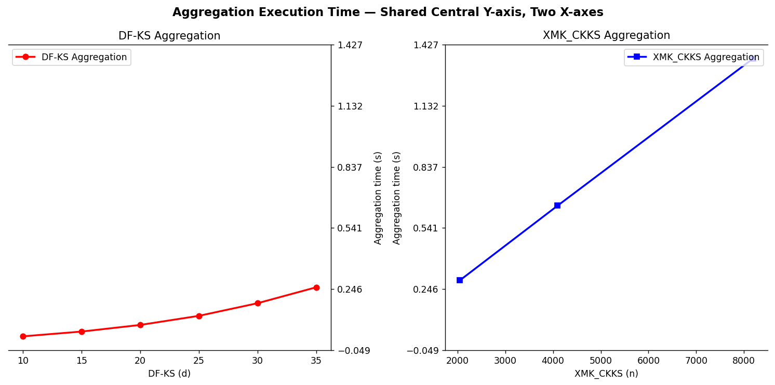
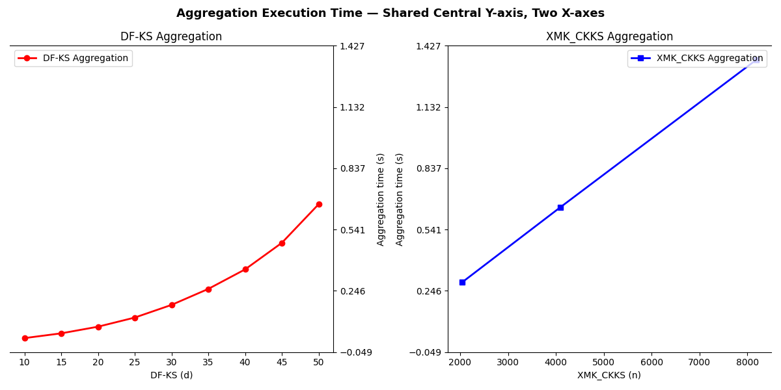
9. Results
(Execution Time)
Encryption execution time for both schemes

Slide 30
9. Results
(Execution Time)
Aggregation Execution time for both schemes

Slide 31
9. Results
(Memory Allocation)
 | DF_KS |  | XMK_CKKS
 | Size in bit | Size in byte | Size in bits | Size in Bytes
plain text | 512 | 64 | 640 | 80
cipher text | 1152 | 144 | 5056 | 632
overhead | 1.25 | 1.25 | 6.9 | 6.9

Slide 32
 | DF_KS |  | XMK_CKKS
 | Size in bit | Size in byte | Size in bits | Size in Bytes
plain text | 512 | 64 | 640 | 80
cipher text | 1152 | 144 | 5056 | 632
overhead | 1.25 | 1.25 | 6.9 | 6.9
10. Conclusion (Summary)
Feature | DF-KS | xMK CKKS
Adversarial Model | Protects against honest-but-curious clients. If one client is compromised, the network remains secure. | Protects against honest-but-curious clients. If one client is compromised, the network remains secure.
Server Decryption Ability | Server cannot decrypt. | Server is allowed to decrypt.
Homomorphism | Supports homomorphic operations. | Supports homomorphic operations.
Decryption Requirement | Each client can decrypt independently (no need for all clients to be present). | All clients must be present to decrypt the weighted average.
Resistance to Attacks | Not resistant to known plaintext–ciphertext attacks. | Immune against known plaintext–ciphertext attacks.
Encryption Execution Time | More efficient. | Less efficient.
Storage & Communication | Lower overhead. | Higher overhead.
Aggregation Execution Time | More efficient. | Less efficient.
Client Participation Dependency | Each client decrypts independently; if one client is missing, encryption, decryption, and aggregation proceed normally. | Requires all clients’ key shares for decryption; if one client is missing, the scheme fails to function normally.
Scheme | Limitation | Advantage
xMK CKKS | Decryption on server side only Decryption is not possible if one client is missing | Immune to plaintext/ciphertext couple attack
DF-KS | Vulnerable to plaintext/ciphertext couple attack | Decryption happens on client side If one client goes missing decryption remains possible

Slide 33
Feature | DF-KS | xMK CKKS
Adversarial Model | Protects against honest-but-curious clients. If one client is compromised, the network remains secure. | Protects against honest-but-curious clients. If one client is compromised, the network remains secure.
Server Decryption Ability | Server cannot decrypt. | Server is allowed to decrypt.
Homomorphism | Supports homomorphic operations. | Supports homomorphic operations.
Decryption Requirement | Each client can decrypt independently (no need for all clients to be present). | All clients must be present to decrypt the weighted average.
Resistance to Attacks | Not resistant to known plaintext–ciphertext attacks. | Immune against known plaintext–ciphertext attacks.
Encryption Execution Time | More efficient. | Less efficient.
Storage & Communication | Lower overhead. | Higher overhead.
Aggregation Execution Time | More efficient. | Less efficient.
Client Participation Dependency | Each client decrypts independently; if one client is missing, encryption, decryption, and aggregation proceed normally. | Requires all clients’ key shares for decryption; if one client is missing, the scheme fails to function normally.
10. Conclusion (Summary)
Scheme | Limitation | Advantage
xMK CKKS | Decryption on server side only Decryption is not possible if one client is missing | Immune to plaintext/ciphertext couple attack
DF-KS | Vulnerable to plaintext/ciphertext couple attack | Decryption happens on client side If one client goes missing decryption remains possible
DF-KS has in addition lower overhead and lower execution time

Slide 34
10. Conclusion
(Future Works)
Instead of logistic regression with PIMA dataset
Use larger dataset with a neural network model
Instead of DF-KS scheme
Study and implement CKKS with KS scheme

Slide 35
Thank You
Q&A

